Slide 1
The National Regional Fund Programme

Slide 2
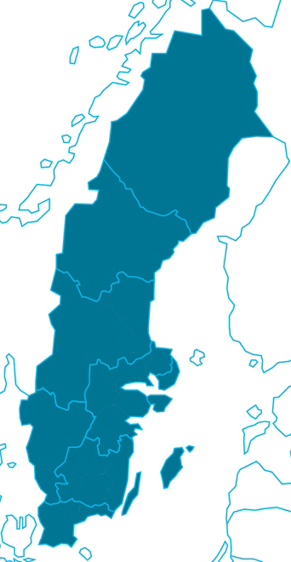
The National Regional Fund Programme
A commission from the Swedish Government aimed at supporting small and medium-sized enterprises (SMEs) to improve the efficiency of their energy usage.
Co-financed by the European Regional Development Fund.
The initiative comprises a number of projects within the framework of the National Regional Fund Programme.
How the National Regional Fund Programme is financed
SEK 80 million a year. SEK 40 million from the Swedish Government and SEK 40 million via the European Regional Development Fund, for which the Swedish Agency for Economic and Regional Growth is the administrative authority.
Notes:
The Swedish Energy Agency has been commissioned by the Government to support small and medium-sized enterprises (SMEs) to optimise their energy usage through support from the European Regional Development Fund. The initiative comprises a number of projects within the framework of the National Regional Fund Programme and will be continuing until 2020. The aim of the programme is to support the transition to a low carbon economy in all sectors.

Slide 3
Vision
Establish working methods and methodologies for energy efficiency work at SMEs at both a national and a regional level.
The companies receive tools for continuing to work in a systematic and structured manner after the end of the projects.
Notes:
Through the projects, the Swedish Energy Agency and its business partners are creating established working methods and methodologies for working on improving energy efficiency at SMEs at both a national and a regional level. In this way, the companies receive the tools they need to continue to work on their energy usage in a systematic and structured manner after the end of the projects.

Slide 4
Goal
The goal that the Agency is working towards is for energy usage at small and medium-sized enterprises to decrease by 10 per cent of added value by 2023.

Slide 5
We aim to achieve these impact goals within the framework of the National Regional Fund Programme
The companies possess a high level of client expertise
The perceived risk associated with improving energy efficiency is low
Improving energy efficiency is a strategic issue for companies
Companies work in a systematic and structured manner on their own energy usage
Energy-efficient products and services are well known, easily accessible, satisfy needs and are developed over time

Slide 6
An initiative focusing on small and medium-sized enterprises (SMEs)
Definition of SMEs:
The number of employees must not exceed 249
The annual turnover must not exceed EUR 50 million or the balance sheet total must not exceed EUR 43 million per year.
Businesses that conduct economic activities, regardless of their legal form.
The criteria apply to the whole corporate group

Slide 7
Co-operation
Several projects are being run by the Swedish Energy Agency alongside business partners.
The Agency is collaborating with:
21 county administrative boards
15 energy agencies
60 municipalities
Energieffektiviseringsföretagen (Energy Efficiency Companies)
Notes:
Through various projects, a network of professional and knowledgeable business partners is being established across the entire country with the aim of optimally engaging and supporting SMEs.

Slide 8
The Swedish Energy Authority’s projects within the National Regional Fund Programme
Networks for improving energy efficiency
Coaches for energy & climate
Support for energy audits
Incentives for improving energy efficiency
Regional nodes
Energy services
Environmental studies – prior to an energy-efficient investment

Slide 9
Networks for improving energy efficiency
Regional networks of companies that want to improve their energy efficiency.
The companies attend network meetings and visit each other.
The companies are entitled to 150 hours of support from energy experts
The networks are co-ordinated by business partners in the form of energy agencies and county administrative boards.
For companies with an energy usage in excess of 1 GWh.

Slide 10
Coaches for energy & climate
The coaches support small companies to improve their energy efficiency.
They work with companies with an energy usage of below 300 MWh.
Around 50 municipalities or municipal collaborations offer coaches.

Slide 11
Support for energy audits
Companies can receive up to SEK 50,000 to carry out an energy audit, which will suggest for profitable investments.
Farms and housing societies can also apply for this support.
For SMEs with an energy usage in excess of 300 MWh.

Slide 12
Incentives for improving energy efficiency
Support for companies that are covered by environmental inspections and enforcement. In conjunction with the environmental inspections and enforcement, the oversight authorities support companies that want to improve their energy efficiency.
The project is conducted with municipalities and county administrative boards as business partners.

Slide 13
Regional nodes
These nodes comprise Sweden’s 15 energy agencies.
The nodes provide support before, during and after companies apply for support from the other two projects, support for energy audits and environmental studies.
The nodes arrange seminars and provide information about the various forms of support that can be applied for.

Slide 14
Energy services
Support, guidance and knowledge-raising initiatives for companies that are going to order energy services.
Support the suppliers to find business models that are adapted to their clients’ actual needs.
The project is being carried out in collaboration with Energieffektiviseringsföretagen (Energy Efficiency Companies).

Slide 15
Environmental studies – prior to an energy-efficient investment
Support for those companies that want to extend their energy work and that have already conducted an audit of their energy usage.
This support may be used to conduct a more in-depth analysis or study, thereby making preparations for an investment aimed at achieving more efficient energy usage.
Companies can receive up to 70 per cent of the total project cost in the form of support.

Slide 16
Support based on energy usage
Networks for improving energy efficiency
Companies with
more than 1 GWh
Energy audit support
Companies with
more than 300 MWh
Regional nodes
Companies that are
covered by environmental inspections and enforcement
Incentives for improving energy efficiency
Companies with
less than 300 MWh
Coaches for energy & climate
Energy services
Environmental studies – prior to an energy-efficient investment
Support for all SMEs

Slide 17
For further information about the projects within the National Regional Fund Programme
energimyndigheten.se/smf
(in Swedish)

